Slide 1
JUMP CP
Making sense of Data

Slide 2
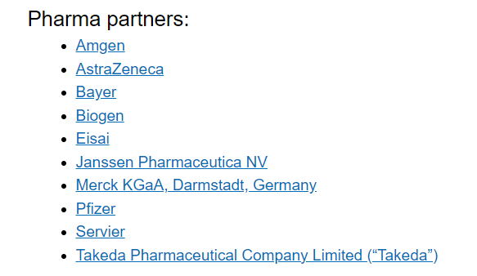
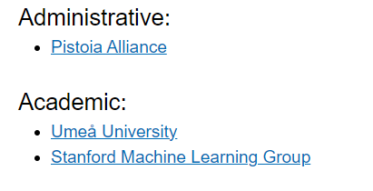
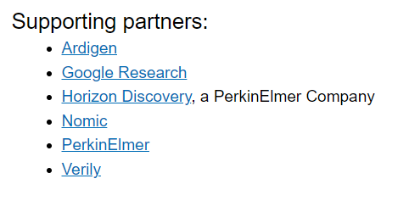
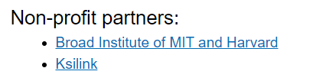
Description

Slide 3
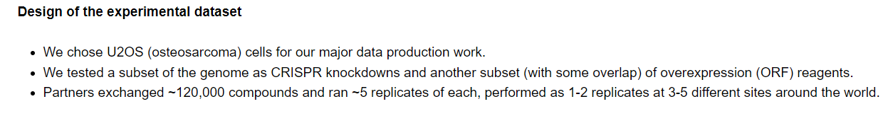
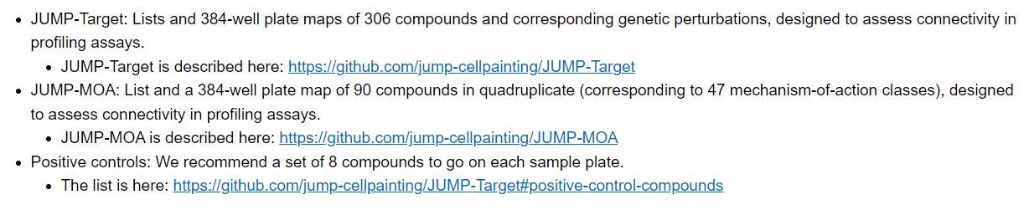
Design

Slide 4
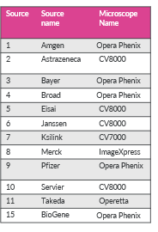
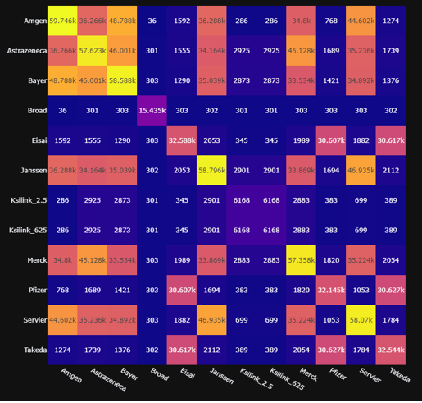
Sources / Microscopes
Intersection between Sources (unique)

Slide 5
In House Dataset
6200 Unique Cpds in 5 replicates and 2 Concentrations (2.5 and 0.625 um)
CRISPR-CAS Druggable genome (7000 in 5 replicates)
More than 100K points

Slide 6


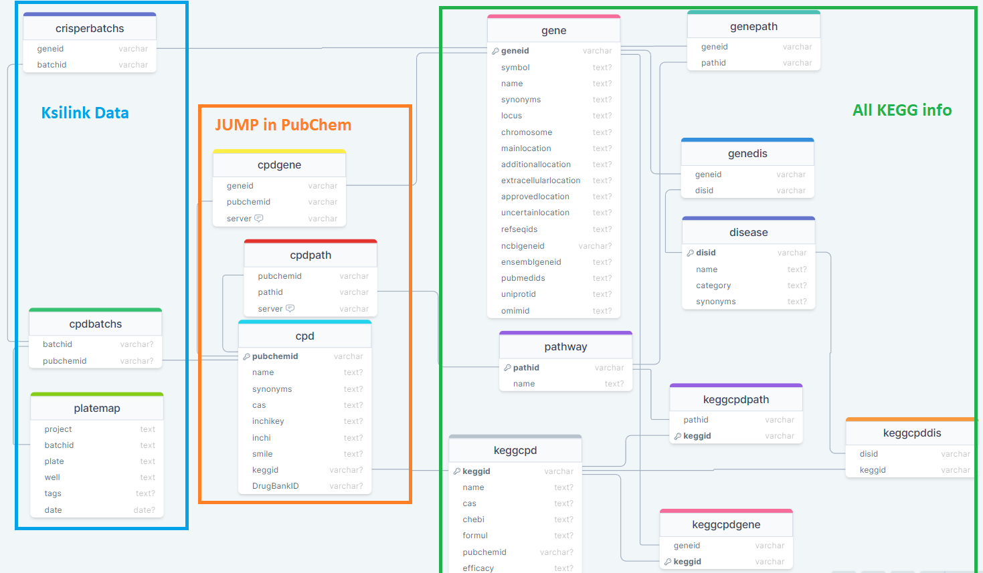


Ksilink Databases
Jump AggProfiles DB
Historical Ksilink DB (in progress)

Slide 7
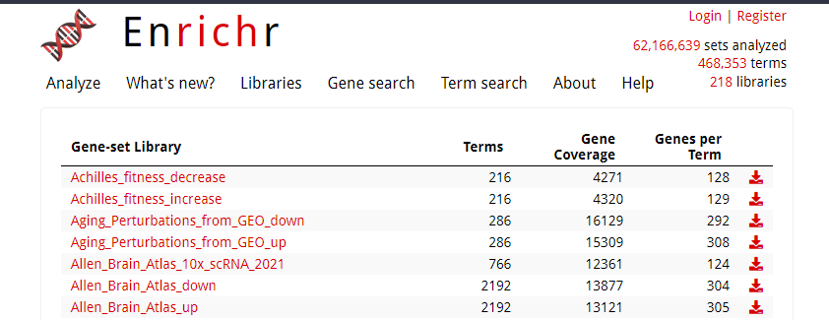
Enrichr Embedded
https://maayanlab.cloud/Enrichr/#libraries

Slide 8

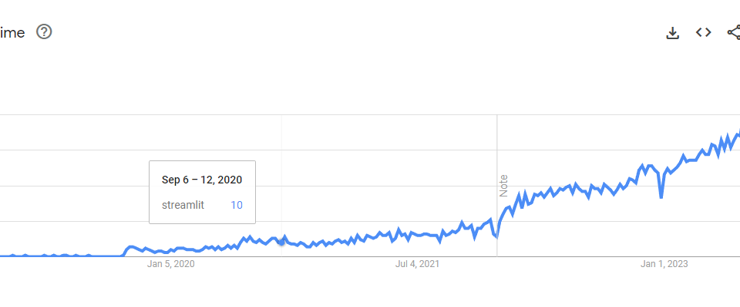
WebApp Interface

Slide 9
